Slide 1
NMMA-EMD Meeting
Miami International Boat Show
EPA Certification/Compliance
February 11, 2015
1

Slide 2
Outline
  Overview of GECC
  Compliance Verification Processes
  Outreach/Compliance Assistance
  Upcoming Items
  Confidential Business Information
2

Slide 3
Overview of the
Gasoline Engine Compliance Center
3

Slide 4
4

Slide 5
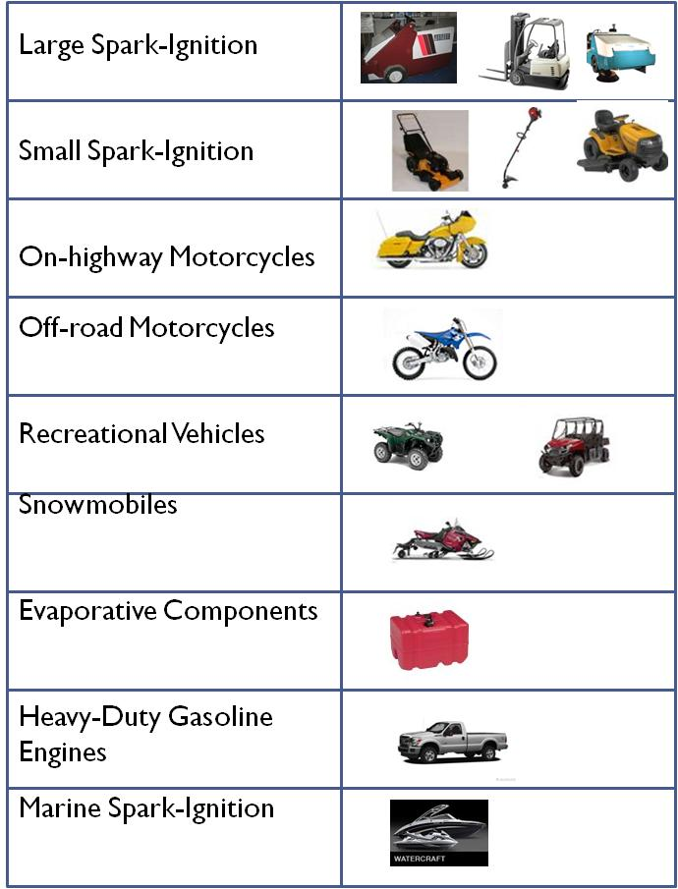
Gasoline Engine Compliance Center
Industry | 2013 MY Certificates
Large SI | 153
Small SI | 924
Motorcycle/ATV | 518
Snowmobile | 30
Evaporative | 765
HDGE | 33
Marine SI | 155
Total | 2,578

Slide 6
Gasoline Engine Compliance Center
On-Highway Motorcycles (40 CFR 86)
On Highway Otto Cycle Engines (40 CFR 86)
Marine Spark Ignition Engines (40 CFR 1045)
Large Spark Ignition Engines> 19 kW (40 CFR 1048; 40 CFR 60-JJJJ)
Recreational Vehicles (40 CFR 1051)
Small Spark Ignition Engines < 19 kW (40 CFR 1054)
Evaporative Emission Regulations (40 CFR 1060)
Portable Fuel Containers (40 CFR 59 F)
6

Slide 7
Compliance Verification Processes
7

Slide 8
Compliance Verification Processes
Application Submission and EPA Review
Confirmatory Test Orders (1045.235(c) )
Selective Enforcement Audits (SEA)(1068-E)
In-Use Test Orders (1045.405(b)(1))
Required Reporting:
    Production Reporting
    PLT Reporting (45 days after “production period” 1045.345(a) )
    ABT Reporting (270 days after end of MY – 1045.730(a) )
    In-Use Testing
8

Slide 9
Confirmatory Testing
40 CFR 1045.235(c)(1) EPA can measure the emissions on your emission data engine and specify the facility where it will be tested.
If your family is selected, a Confirmatory Test Order letter will be sent notifying the manufacturer with directions on where to send the engine, and in what timeframe.
40 CFR 1045.235(c)(2) The results of the EPA confirmatory testing will become the official results in the application for certification.
9

Slide 10
Selective Enforcement Audit (SEA)
(40 CFR 1068, Subpart E)
  EPA issues a test order to manufacturer.
  Manufacturer tests production engines.
    EPA may be present for engine selection and testing.
  Number of engines passing/failing determines if a family passes or not.
  Engine certificate is suspended if family fails the SEA.
10

Slide 11
In-Use Test Orders for Marine SI Engines (1045.405)
Applies only to outboard (OB) and Personal Watercraft (PWC), does not apply to stern-drive/inboard engines (SD/I).
EPA may select up to 25% of a manufacturer’s families in a given MY.
If we receive your application by December 31, we will notify you by February 28 if your family(s) has/have been selected.
If we receive an application after December 31 you must conduct in-use testing of that family (unless waived for SVM ,or recent IU testing)
Test Plan is due by February 28 the following year, or within six months after we approve the application, for applications received after Dec 31.
Testing must be completed 36 months after receiving the EPA TO. Use EPA reporting template.
11

Slide 12
Outreach/Compliance Assistance
12

Slide 13
GECC Outreach/Compliance Assistance
Compliance Assistance
  Instructional Videos
    Diurnal requirements for vessel manufacturers (boat builders and component manufacturers)
    How to certify diurnal fuel systems
  Gasoline Boats and Personal Watercraft website:
  www.epa.gov/otaq/marinesi.htm
  Guidance Letters
Stakeholder Outreach
  Seeking ways to better address compliance concerns of the marine manufacturers and boat builder community
13

Slide 14
Guidance Documents Planned for 2015 for Marine SI
Revision of Assigned Deterioration factors (DF’s) for 2016-2017 Model Year
  Existing recent DF data is analyzed, sorted by technology type (service class, cycle type, aftertreatment)
  EPA plans to offer the industry an opportunity to review the assigned DF’s prior to finalizing the guidance.
Guidance on engine mapping and duty cycle generation using the provisions of 40 CFR 1045 and 40 CFR 1065.
14

Slide 15
Upcoming
Items
15

Slide 16
California E10 Fuel in 2020
40 CFR 1045.501(c) Fuels. Use the fuels and lubricants specified in 40 CFR part 1065, subpart H, for all the testing we require in this part…
40 CFR 1045.501(c)(1) currently allows the option of certifying with a 90% blend of certification gasoline/ethanol (Specifications in 40 CFR 1065.710.)
Additionally, from 40 CFR part 1065, subpart H…
40 CFR 1065.701(b) Fuels meeting alternate specifications. We may allow you to use a different test fuel (such as California Phase 2 gasoline) if it does not affect your ability to show that your engines would comply with all applicable emission standards using the fuel specified in this subpart. (Note, EPA must approve this request)
40 CFR 1045.501(c)(1) … If you use the blended fuel for certifying a given engine family, we may use the blended fuel or the specified gasoline test fuel with that engine family.
16

Slide 17
Technical Amendments
Direct Final Rule (DFR) was signed on February 2, 2015
Publication in the Federal Register should occur in late February or early March
DFR includes changes to 40 CFR 1060.515 (Evaporative Emissions)
Part 1060 changes simplify the test procedure for narrow I.D. fuel lines (< 5 mm); DFR references new SAE procedure designed to eliminate variability due to bubble entrainment in smallest fuel lines.
Primarily affects Small Handheld SI Engines, unlikely to affect Marine SI evaporative emission certification.
17

Slide 18
Confidential Business Information
EPA’s Office of General Counsel (OGC) has made a class determination on the confidentiality status of certification data: (http://www.epa.gov/ogc/documents/1-13.pdf )
A similar evaluation of compliance data (post-certification information such as production volume/ ABT credits) is currently being reviewed.
Certification Division continues to work with OGC on responses to the comments (including NMMA’s comments)
EPA intends to meet with stakeholders before a final determination is made.
Questions should be directed to Holly Pugliese (pugliese.holly@epa.gov)
18

