Slide 1

Conference Issues Briefing
April 28, 2010

Slide 2




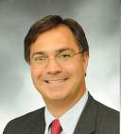

On Today’s Webinar
Bryan Welsh
Webinar Moderator &
Director of Membership
Cindy Squires
NMMA Chief Counsel
Mat Dunn
Legislative Director
Jeff Gabriel
NMMA Legislative Counsel
Christine Pomorski
PR Manager for Government Relations

Slide 3
On Today’s Webinar
Introduction
Floorplan Financing
National Oceans Policy
Ethanol
State of the Marine Industry
Q&A
Hill Visits 101
BoatPAC

Slide 4
Conference Materials
Download policy briefs and talking points online at:
http://www.nmma.org/government/federal/?catid=1800
(If the link does not work, go to www.nmma.org/government
then click on Federal Relations, then ABC 2010.)
Hard copies of these documents will be available at registration.

Slide 5






















THANK YOU TO OUR SPONSORS
Admiral’s Level
Captain’s Level
First Mate’s Level
Purser’s Level

Slide 6
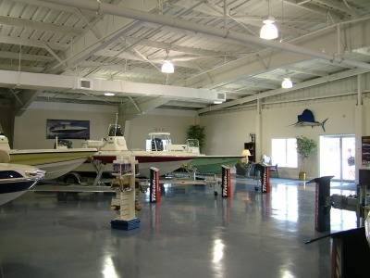
Floorplan
Financing
PRESENTED BY
Cindy Squires

Slide 7

Floorplan Financing
Marine Industry Finance Exodus
  Mass exodus of lenders began in 2007
  Credit gap caused enormous job losses; disruptions in distribution chain
  Must expand and diversify lending market
  Credit gap remains
Notes:
Tell our story. In 2007, marine retail new boat and engine sales totaled $14.5 billion, with an inventory value of less than $8 billion at 2 turns per year. Total marine industry floor plan market was approximately $3-4 billion at that time Mass exodus of traditional lenders began in 2007, leaving massive gap in floorplan lending. Credit gap led directly to enormous job losses; disruptions in distribution chain Must expand and diversify lending market National credit conditions still weak. Federal government actions to date (TALF/SBA) insufficient

Slide 8
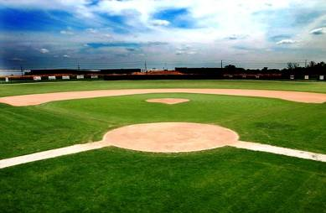
Floorplan Financing
We built it but they didn’t come….
Small Business Administration DFP Pilot announced at ABC 2009
SBA created uncertainty with terms – only a 1 year pilot
Expected 4,000 deals by Oct. 2009 – only 60 have been made
Notes:
Launched in July 2009; NMMA major instigator
Established a pilot 7(a) loan guaranty program dedicated for lines of credit that provide floor plan financing
Current limit $2M guarantee @ different rates for 7(a) reg loans (90%) than floor plan loans.
Harmful, extraneous limits on trade and restriction on lender participation
One year pilot program, expires Sept. 2010
SBA expected 4,000 deals by Oct. 2009 / currently roughly 60
National banks not participating
Too much programmatic uncertainty
SBA inexperience in this type of highly-revolving credit

Slide 9
Floorplan Financing
What We Want from Congress
  Pass S. 2869, Small Business Job Creation and Access to Capital Act – the “Jobs 3” Bill
    Increases loan caps to $5M; eliminates fees; extends 90% guarantee
  With Floor Plan Amendments
    Direct SBA to extend DFP program to at least 5 years
    Must change SBA DFP program to increase appeal to lenders
  Low cost, low-risk, job-growing solution.
  White House supports; bipartisan Senate support; challenge is House of Representatives
Notes:
Pass S. 2869, Small Business Job Creation and Access to Capital Act
Sponsored by Landrieu, Snowe; 23 bipartisan cosponsors
Increases loan caps to $5M; eliminates fees; extends 90% guarantee
Must be amended to extend SBA DFP program to at least 5 years
Must include substantive requirements to change SBA DFP program to increase appeal to lenders (NMMA has provided a number of simple changes to remove lender barriers to participation).
This is the “Jobs 3” Bill, coming up soon – industry must unite to pressure Congress to include these changes
Low cost, low-risk, job-growing solution. Credit is key
White House supports; bipartisan Senate support; challenge is House of Representatives

Slide 10
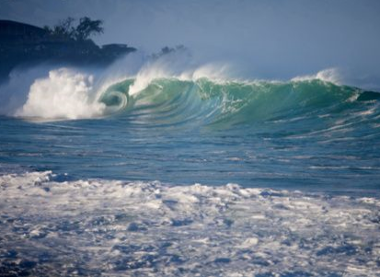
National Oceans Policy
Presented by
Mat Dunn

Slide 11
National Oceans Policy
President’s Interagency Oceans Policy Task Force
  Established by Executive Memorandum, June 2009
  Composed of all relevant federal agencies
  Led by White House Council on Environment Quality
  First report was Interim Report on National Oceans Policy
  Second report was on Coastal and Marine Spatial Planning
Public Comment
  NMMA and fishing/conservation partners commented on both documents throughout process
  Met w/ CEQ, NOAA, FWS officials throughout process
Stated Goal
  Improve oceans management through coordinated planning
  Implement system of marine spatial planning

Slide 12
National Oceans Policy
Policy Proposal
  Create National Ocean Council (NOC) with broad authority, chaired by CEQ and OSTP
  Establish National Ocean Policy with Priority Objectives
  Establish Regional Ocean Councils
  Implement Coastal and Marine Spatial Planning, including Great Lakes and possible upland areas
Key Concerns
  Federal top-down approach
  New bureaucratic overlay and confusion
  Insufficient recognition of importance of recreation
  New marine protected areas
  Stakeholder process and transparency

Slide 13
National Oceans Policy
What We Want
  Make recreation a National Priority under National Ocean Policy
  Promote and enhance recreational access/opportunities
  Meaningful, binding, frequent stakeholder process
  No top-down federal approach
  Preserve existing authorities
What We Want from Congress
  Weigh in to protect recreational opportunities
  Prevent Executive Order
  Preserve Congressional authorities, oversight, regular order

Slide 14

Ethanol
Presented by
Mat Dunn

Slide 15
Ethanol
Growth Energy Waiver Petition for E15
  Filed March 2009
  More than 30,000 comments from boaters and marine industry
  Decision due Dec. 1, 2009, but EPA exceeded deadline
  EPA expected to issue partial waiver based on limited auto testing this summer
Problem
  Marine equipment not designed, calibrated, certified or warranted to run on E15
  No testing of marine equipment
  Growth Energy petition woefully inadequate on data
  Performance, air emissions, warranty, and consumer safety concerns for marine equipment

Slide 16
Ethanol
Why We Don’t Like E15
  It’s a boondoggle
  It’s bad for consumers—damages equipment
  It’s bad for air quality—increases Nox Emissions and will defeat catalysts over their full useful life
  It’s a bad fuel – shelf life of 90 days
  It’s bad for fuel economy – more gas, less distance, less power
EPA Doesn’t Have the Data to Justify Approval
  No marine testing
  Insufficient auto and other testing
  Partial Waiver will cause consumer confusion and misfuels

Slide 17
Ethanol
Legislative Solution
  S. 1666, Mid-Level Ethanol Blends Act (Collins-Cardin)
  Requires SAB study of impacts on consumers, compatible fuel availability
  Prevents any EPA decision for 1 year until SAB study completion
  Would prevent partial waiver until all on-road and non-road vehicle fleet is compatible
  Cosponsors: Cardin (D-Md.), Landrieu (D-La.), Vitter (R-La.), Burr (R-N.C.), Whitehouse (D-R.I.), Webb (D-Va.)
  Need additional bipartisan cosponsors
  Request that S. 1666 be included as part of upcoming energy bill.
  This is a consumer safety issue!
  Broad coalition support: oil, enviros, consumer, food, etc.

Slide 18
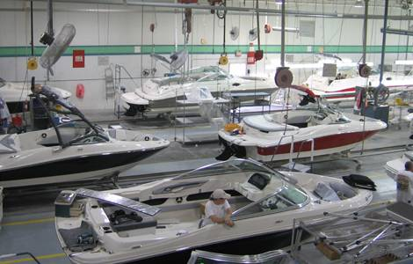
State of the Industry
Presented by
Mat Dunn

Slide 19
State of the Industry
Boating is major consumer goods and services industry
  $30B new sales and services 2009
  13M registered recreational boats
  70M boaters in 2009
  Over 18,000 marine businesses nationwide supporting over 300,000 jobs
  Middle-class activity – 75% boat owners have household income of less than $100K per year
  90% of boats under 26 feet (trailerable)
Major Challenges for the Boating Industry
  Credit liquidity and capital access
  Inventory financing
  Consumer confidence and demand

Slide 20
State of the Industry
Impact of the Recession on the Boating Industry – Key Facts & Figures
  Traditional 2009 boat sales down 70% at wholesale and 29% at retail
  Outboard engine sales down 34% to 180,700 engines compared to 227,000 in 2008
  2009 aftermarket accessory sales projected to decrease 7% to $2.2 billion vs. 2008
  All segments of industry hit hard
  At least 70% unemployment levels at peak; remaining workers not FTE
  At least 135,000 jobs lost; ~200 plant closures in 2008
  Expected 50% dealer closure in the industry

Slide 21
State of the Industry
Why These Numbers Matter to Congress
  The boating industry is primarily a U.S. manufacturing and services industry
  Our industry is about U.S. jobs – tell your company’s story
  Boating industry is one of the last few net exporters, contributing to trade balance
  Our industry is about middle-class jobs for middle-class consumers
  Boat, engine and accessory plants, marinas, etc. anchor local communities throughout U.S.
  Credit liquidity, not demand, is the key issue
  Congress must seriously address boating industry challenges to create jobs in the U.S.

Slide 22

Q & A
Moderated by
Bryan Welsh

Slide 23
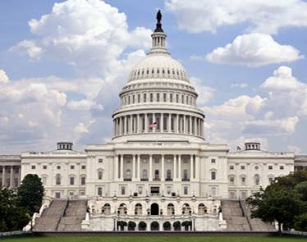
Hill Visits 101
PRESENTED BY
Jeff Gabriel

Slide 24
Hill Visits 101
Before you head to the Hill
  Pack appropriately: business attire is appropriate for Hill visits (good walking dress shoes help, too)
  Do some light research on your Representative and Senators by visiting their websites and reading their press releases, committee assignments, etc.
  You will receive your Hill schedule at the start of the conference when you register on site at ABC.
  Keep an eye on your cell phone while in DC – if there are any last-minute changes, you will hear from Laura Genovese.
  Coordinate with others in your state delegation if you are going in a small group.
Notes:
Congressional schedules often change last-minute or are not finalized until the week before – this is why we can’t send your Hill schedule ahead of time.

Slide 25
Hill Visits 101
Heading up to the Hill
  Leave plenty of time to go through security, find the office and arrive a few minutes early. It’s about a 15 minute walk to Senate offices and a 25 minute walk to House offices.
  Bring business cards and have plenty of issue briefs to leave behind during your visit. You will receive extra copies at registration.
  If you have requested an NMMA staff escort, your assigned staff member will coordinate with you after the luncheon.
  Most importantly, have fun!
Notes:
We have done our best to provide everyone who requested an NMMA staff person with someone to escort them, but please understand that because of the timing of the Hill visits, one may not be available.

Slide 26
Hill Visits 101
Useful things to know for your Hill visit
  Products manufactured: be able to articulate how/where your products are used and sold in a few sentences.
  Jobs: know how many people you employ.
  History: tell the story of the history of your business and its importance in the community.
  Success stories: have a few examples of how your business overcame challenges or contributed to the local community.

Slide 27
Hill Visits 101
During your Hill visit
  Be flexible: Due to fluid nature of Congressional activities, you may be asked to wait, meet with another staffer or meet in another location.
  Clearly introduce yourself, your group and your company.
  Tell your story briefly and clearly. Talk about how long you’ve been in your community, how many people you employ, etc.
  If you are there to talk about specific legislation, know the bill name and number. This info can be found in your policy briefs.
  If you are asked a question you don’t know the answer to, be honest. Let the office know you will find out and follow up with an email later.
  At the end of your meeting, thank the Member of Congress and/or staffer for their time and previous support (if applicable). Trade business cards. Invite them to the Congressional Boating Caucus Reception in Rayburn B369 from 4:30 to 6:30 pm that afternoon.
  If you can, invite them to tour your facility during the August recess.
Notes:
August recess is scheduled for August 9 to September 13. This may change, however.
You will receive Caucus Reception invites at registration as well.
For facility tours, please be clear that you welcome key staff with or without the Member.

Slide 28
Hill Visits 101
After your Hill visit
  Follow up with a thank you email. Include any additional information requested, a brief overview of your “ask” and a reminder that you will follow up later in the summer about an August facility tour.
  In July, follow up with another email inviting your Member of Congress and their staff on a facility tour.
  Contact NMMA if you need help with organizing a Congressional visit.

Slide 29
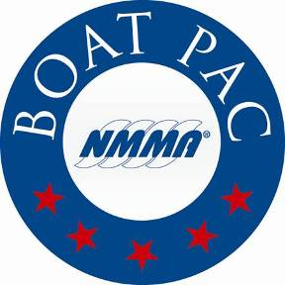
BoatPAC
Another way to get involved
  NMMA has a Political Action Committee called Boat PAC
  Boat PAC provides financial support to U.S. Senate and House candidates and is the recreational boating industry’s strongest tool to enact political change in our federal government
  Boat PAC & Center PAC will host the Hook, Line and Cinco de Mayo PAC Fiesta on Wed, May 5 at 6:30 pm on the rooftop of the Liaison
  Contact Jeff Gabriel (202-737-9776; jgabriel@nmma.org) for more information on Boat PAC, including how you may be able to get involved

Slide 30
Hill Visits Q & A
Moderated by
Bryan Welsh
Notes:
30

Slide 31
Contact Us
Bryan Welsh
Webinar Moderator &
Director of Membership
312-946-6276
bwelsh@nmma.org
Cindy Squires
NMMA Chief Counsel
202-737-9766
csquires@nmma.org
Mat Dunn
Legislative Director
202-737-9760
mdunn@nmma.org
Jeff Gabriel
NMMA Legislative Counsel
202-737-9776
jgabriel@nmma.org
Christine Pomorski
PR Manager for Government Relations
202-7373-9774
cpomorski@nmma.org

Slide 32
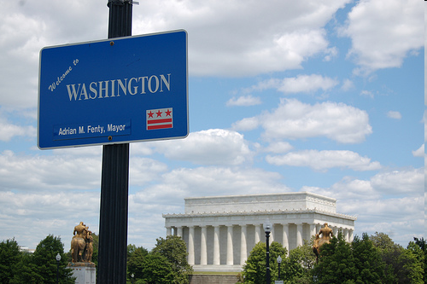
Thank you for participating and see you next week at the American Boating Congress!
Notes:
32

